Slide 1
Dispense Ads based on number of times dispensed - SDAB
Technical design

Slide 2
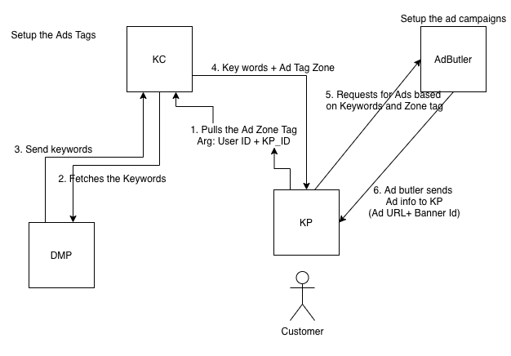
Ads Architecture

Slide 3
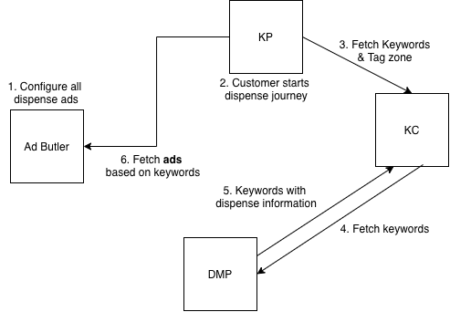
Dispense Ads functionality

Slide 4
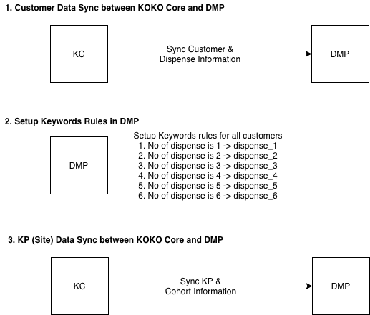
Requirements - Add dispense info in DMP

Slide 5
Audience & Audience keywords Table
Audience
id | user_id | user_profile | user_phone
<db_id> | <kc_db_id> | {"dob_year": 1984, "gender": "female", "avg_fuel_purchase": 3898, “dispense_count”: 3} | <user_phone_number>
Audience Keyword Mapper
id | audience_id | audience_keywords | audience_phone
<db_id> | <audience_id_foreign_key> | {} | <user_phone_number>

Slide 6
Sites & Site keywords Table
Site
id | site_id | site_profile
<db_id> | <kc_KP_db_id> | {"location": <kp_neighbourhood>}
Site Keyword Mapper
id | site_id | site_keywords | site_name
<db_id> | <kc_KP_db_id> | {<kp_neighbourhood>, <cohort>} | <site_name>

Slide 7
Keywords Table
Keyword
id | keyword_rules | keyword
<db_id> | [{"detail": "gender", "value": "male", "operator": "="}] | male
<db_id> | [{"detail": "dispense_count", "value": "1", "operator": "="}] | dispense_1

